Slide 1

MySQL + PHP

Slide 2
Querying a MySQL Database with PHP
The reason for using PHP as an interface to MySQL is to format the results of SQL queries in a form visible in a web page.
When MySQL returns its response, it will come as a data structure that PHP can recognize instead of the formatted output you see when you work on the command line.

Slide 3
The process of using MySQL with PHP is as follows:
Connect to MySQL and select the database to use.
Build a query string.
Perform the query.
Retrieve the results and output to a web page.
Repeat steps 2 to 4 until all desired data has been retrieved.
Disconnect from MySQL.
Security critical steps!

Slide 4
Creating a Login File
Most websites developed with PHP contain multiple program files that will require access to MySQL and will thus need the login and password details.
Therefore, it’s sensible to create a single file to store these and then include that file wherever it’s needed.
<?php // login.php
$hn = 'localhost’;
$un = 'username’;
$pw = 'password’;
$db = 'publications’;
?>
Type the example, replacing username and password with the values you use for your MySQL database, and save it to the document root directory you set up

Slide 5
The $hn variable will tell PHP which computer to use when connecting to a database.
This is required, because you can access MySQL databases on any computer connected to your PHP installation, and that potentially includes any host anywhere on the web.

Slide 6
TIP: Another benefit of keeping these login details in a single place is that you can change your password as frequently as you like and there will be only one file to update when you do, no matter how many PHP files access MySQL.

Slide 7
Connecting to a MySQL Database
Now that you have the login.php file saved, you can include it in any PHP files that will need to access the database by using the require_once statement.
This is preferable to an include statement, as it will generate a fatal error if the file is not found.
Also, using require_once instead of require means that the file will be read in only when it has not previously been included, which prevents wasteful duplicate disk accesses.

Slide 8
<?php
require_once 'login.php’;
$conn = new mysqli($hn, $un, $pw, $db);
if ($conn->connect_error) die($conn->connect_error);
?>
This example creates a new object called $conn by calling a new instance of the mysqli method, passing all the values retrieved from the login.php file.
Error checking is achieved by referencing the $conn->connect_error property.
Notes:
Connecting to a MySQL server with mysqli

Slide 9
<?php
require_once 'login.php’;
$conn = new mysqli($hn, $un, $pw, $db);
if ($conn->connect_error) die($conn->connect_error);
?>
The -> operator indicates that the item on the right is a property or method of the object on the left.
In this case, if connect_error has a value, then there was an error, so we call the die function and display that property, which details the connection error.
The $conn object is used in the following examples to access the MySQL database.
Notes:
Connecting to a MySQL server with mysqli

Slide 10
The die function is great for when you are developing PHP code, but of course you will want more user-friendly error messages on a production server. In this case, you won’t abort your PHP program, but format a message that will be displayed when the program exits normally, perhaps something like this:
function mysql_fatal_error($msg, $conn)
{
$msg2 = mysqli_error($conn);
echo <<< _END
We are sorry, but it was not possible to complete
the requested task. The error message we got was:
<p>$msg: $msg2</p>
Please click the back button on your browser
and try again. If you are still having problems,
please <a href="mailto:admin@server.com">email
our administrator</a>. Thank you.
_END;
}

Slide 11
Building and executing a query
Sending a query to MySQL from PHP is as simple as issuing it using the query method of a connection object.
<?php
$query = "SELECT * FROM classics";
$result = $conn->query($query);
if (!$result) die($conn->error);
?>
Here the variable $query is assigned a string containing the query to be made, and then passed to the query method of the $conn object, which returns a result that we place in the object $result
If $result is FALSE, there was a problem and the error property of the connection object will contain the details, so the die function is called to display that error.
All the data returned by MySQL is now stored in an easily interrogatable format in the $result object.

Slide 12
Fetching a result
Once you have an object returned in $result, you can use it to extract the data you want, one item at a time, using the fetch_assoc method of the object.
See example in the next slide…

Slide 13
<?php // query.php
require_once 'login.php’;
$conn = new mysqli($hn, $un, $pw, $db);
if ($conn->connect_error) die($conn->connect_error);
$query = "SELECT * FROM classics";
$result = $conn->query($query);
if (!$result) die($conn->error);
$rows = $result->num_rows;
…

Slide 14
…
for ($j = 0 ; $j < $rows ; ++$j)
{
$result->data_seek($j);
echo 'Author: ' . $result->fetch_assoc()['author'] . '<br>’;
$result->data_seek($j);
echo 'Title: ' . $result->fetch_assoc()['title'] . '<br>’;
$result->data_seek($j);
echo 'Category: ' . $result->fetch_assoc()['category'] . '<br>’;
$result->data_seek($j);
echo 'Year: ' . $result->fetch_assoc()['year'] . '<br>’;
$result->data_seek($j);
echo 'ISBN: ' . $result->fetch_assoc()['isbn'] . '<br><br>’;
}
$result->close();
$conn->close();
?>

Slide 15
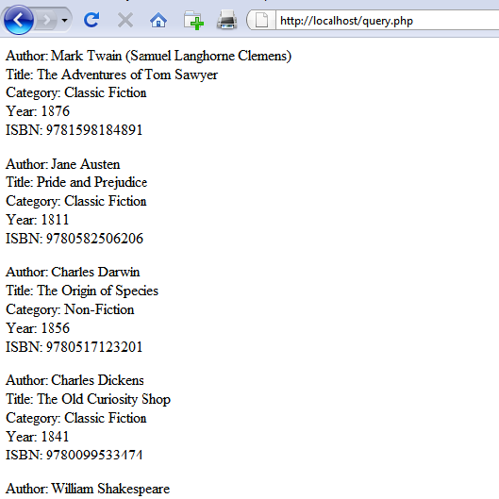

Slide 16
Here, to seek to the correct row each time around the loop, we call the data_seek method of $result before fetching each item of data.
Then we call the fetch_assoc method to retrieve the value stored in each cell, and output the result using echo statements.

Slide 17
Fetching a row
Is there a more efficient method of achieving the same result?
Yes, there is a better method, which is to extract a row at a time.
See example in the next slide…

Slide 18
<?php //fetchrow.php
require_once 'login.php’;
$conn = new mysqli($hn, $un, $pw, $db);
if ($conn->connect_error) die($conn->connect_error);
$query = "SELECT * FROM classics";
$result = $conn->query($query);
if (!$result) die($conn->error);
$rows = $result->num_rows;
…

Slide 19
…
for ($j = 0 ; $j < $rows ; ++$j)
{
$result->data_seek($j);
$row = $result->fetch_array(MYSQLI_ASSOC);
echo 'Author: ' . $row['author'] . '<br>’;
echo 'Title: ' . $row['title'] . '<br>’;
echo 'Category: ' . $row['category'] . '<br>’;
echo 'Year: ' . $row['year'] . '<br>’;
echo 'ISBN: ' . $row['isbn'] . '<br><br>’;
}
$result->close();
$conn->close();
?>
This returns a single row of data as an array, which is then assigned to the array $row
Notes:
In this modified code, only one-fifth of the interrogations of the $result object are made (compared to the previous example), and only one seek into the object is made in each iteration of the loop, because each row is fetched in its entirety via the fetch_array method.

Slide 20
The fetch_array method can return three types of array according to the value passed to it:
MYSQLI_NUM
Numeric array. Each column appears in the array in the order in which you defined it when you created (or altered) the table.
In our case, the zeroth element of the array contains the Author column, element 1 contains the Title, and so on.

Slide 21
MYSQLI_ASSOC
Associative array. Each key is the name of a column.
Because items of data are referenced by column name (rather than index number), use this option where possible in your code to make debugging easier and help other programmers better manage your code.
MYSQLI_BOTH
Associative and numeric array.
Notes:
Associative arrays are usually more useful than numeric ones because you can refer to each column by name, such as $row['author'], instead of trying to remember where
it is in the column order.
So this script uses an associative array, leading us to pass MYSQLI_ASSOC.

Slide 22
Closing a connection
The memory is freed automatically when the PHP scripts ends
PHP will eventually return the memory it has allocated for objects after you have finished with the script, so in small scripts, you don’t usually need to worry about releasing memory yourself.
But maybe that memory could be useful to script…
However, if you’re allocating a lot of result objects or fetching large amounts of data, it can be a good idea to free the memory you have been using to prevent problems later in your script.
This becomes particularly important on higher-traffic pages, because the amount of memory consumed in a session can rapidly grow.
So, as soon as each object is no longer needed, do this:
$result->close();
$conn->close();

Slide 23
Closing a connection
Ideally, you should close each result object when you have finished using it, and then close the connection object when your script will not be accessing MySQL anymore.
This best practice ensures that resources are returned to the system as quickly as possible to keep MySQL running optimally, and alleviates doubt over whether PHP will return unused memory in time for when you next need it.

Slide 24
Recap
Use an external file with login information and “require_once” it
Open a connection to the database with:
$conn = new mysqli($hn, $un, $pw, $db);
Check for errors in this way:
if ($conn->connect_error) die($conn->connect_error);
Or better:
if ($conn->connect_error) die(mysql_fatal_error(“OOPS”));

Slide 25
Recap
Query the database with:
$result = $conn->query("SELECT * FROM classics");
Read the results with:
$result->data_seek($j);
$row = $result->fetch_array(MYSQLI_ASSOC);
Close the connection with:
$result->close();
$conn->close();

Slide 26
A Practical Example
It’s time to write our first example of inserting data in and deleting it from a MySQL table using PHP.
The code in the next slides
First checks for any inputs that may have been made
Then either inserts new data into the table classics of the publications database or deletes a row from it, according to the input supplied.
Regardless of whether there was input, the program then outputs all rows in the table to the browser.
So let’s see how it works…

Slide 27
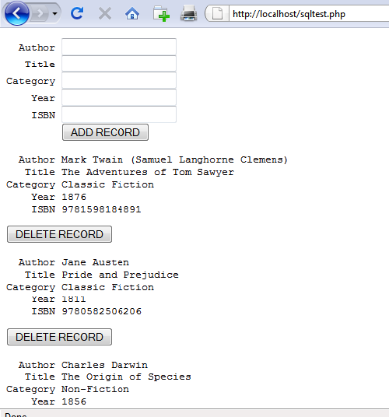

Slide 28
<?php // sqltest.php
require_once 'login.php’;
$conn = new mysqli($hn, $un, $pw, $db);
if ($conn->connect_error) die($conn->connect_error);
if (isset($_POST['delete']) && isset($_POST['isbn']))
{
$isbn = get_post($conn, 'isbn’);
$query = "DELETE FROM classics WHERE isbn='$isbn’”;
$result = $conn->query($query);
if (!$result) echo "DELETE failed: $query<br>" .
$conn->error . "<br><br>";
}
…
Notes:
The first section of new code starts by using the isset function to check whether values for all the fields have been posted to the program.
Upon confirmation, each line within the if statement calls the function get_post, which appears at the end of the program. This function has one small but critical job: fetching input from the browser.

Slide 29
…
if (isset($_POST['author']) && isset($_POST['title']) &&
isset($_POST['category']) && isset($_POST['year']) &&
isset($_POST['isbn']))
{
$author = get_post($conn, 'author’);
$title = get_post($conn, 'title’);
$category = get_post($conn, 'category’);
$year = get_post($conn, 'year’);
$isbn = get_post($conn, 'isbn’);
$query = "INSERT INTO classics VALUES" .
"('$author', '$title', '$category', '$year', '$isbn')";
$result = $conn->query($query);
if (!$result) echo "INSERT failed: $query<br>" . $conn->error . "<br><br>";
}
…

Slide 30
…
echo <<<_END
<form action="sqltest.php" method="post"><pre>
Author <input type="text" name="author">
Title <input type="text" name="title">
Category <input type="text" name="category">
Year <input type="text" name="year">
ISBN <input type="text" name="isbn">
<input type="submit" value="ADD RECORD">
</pre></form>
_END;
$query = "SELECT * FROM classics";
$result = $conn->query($query);
if (!$result) die ("Database access failed: " . $conn->error);
$rows = $result->num_rows;
…

Slide 31
…
for ($j = 0 ; $j < $rows ; ++$j)
{
$result->data_seek($j);
$row = $result->fetch_array(MYSQLI_NUM);
echo <<<_END
<pre>
Author $row[0]
Title $row[1]
Category $row[2]
Year $row[3]
ISBN $row[4]
</pre>
<form action="sqltest.php" method="post">
<input type="hidden" name="delete" value="yes">
<input type="hidden" name="isbn" value="$row[4]">
<input type="submit" value="DELETE RECORD"></form>
_END;
}
…

Slide 32
…
$result->close();
$conn->close();
function get_post($conn, $var)
{
return $conn->real_escape_string($_POST[$var]);
}
?>

Slide 33
The $_POST Array
I mentioned in an earlier lecture that a browser sends user input through either a Get request or a Post request.
The Post request is usually preferred (because it avoids placing unsightly data in the browser’s address bar), and so we use it here.
The web server bundles up all of the user input (even if the form was filled out with a hundred fields) and puts in into an array named $_POST

Slide 34
The $_POST Array
Depending on whether a form has been set to use the Post or the Get method, either the $_POST or the $_GET associative array will be populated with the form data.
They can both be read in exactly the same way.
Each field has an element in the array named after that field.
Example: $_POST['isbn'] or $_POST["isbn"]

Slide 35
The $_POST Array
There is no reason to write to an element in the $_POST array.
Its only purpose is to communicate information from the browser to the program, and you’re better off copying data to your own variables before altering it.
TIP: So, back to the get_post function, which passes each item it retrieves through the real_escape_string method of the connection object to strip out any characters that a hacker may have inserted in order to break into or alter your database, like this:
function get_post($conn, $var)
{
return $conn->real_escape_string($_POST[$var]);
}

Slide 36
Deleting a Record
Prior to checking whether new data has been posted, the program checks whether the variable $_POST['delete'] has a value.
If so, the user has clicked the DELETE RECORD button to erase a record.
In this case, the value of $isbn will also have been posted.
As you’ll recall, the ISBN uniquely identifies each record.
The HTML form appends the ISBN to the DELETE FROM query string created in the variable $query, which is then passed to the query method of the $conn object to issue it to MySQL.

Slide 37
Deleting a Record
If $_POST['delete'] is not set, $_POST['author'] and other posted values are checked.
If they have all been given values, then $query is set to an INSERT INTO command, followed by the five values to be inserted.
The string is then passed to the query method, which upon completion returns either TRUE or FALSE.
If FALSE is returned, the error message held in the error property of the $conn object is displayed, like this:
if (!$result) echo "INSERT failed: $query<br>" . $conn->error . "<br><br>";

Slide 38
Displaying the Form
You should recall the echo <<<_END..._END structure from previous lectures, which outputs everything between the _END tags.
Instead of the echo command, the program could also drop out of PHP using ?>, issue the HTML, and then reenter PHP processing with <?php.
Whichever style used is a matter of programmer preference, but I always recommend staying within PHP code for these reasons:
It makes it very clear when debugging (and also for other users) that everything within a .php file is PHP code. Therefore, there is no need to go hunting for dropouts to HTML.
When you wish to include a PHP variable directly within HTML, you can just type it. If you had dropped back to HTML, you would have had to temporarily reenter PHP processing, access the variable, and then drop back out again.

Slide 39
Displaying the Form
The HTML form section simply sets the form’s action to sqltest.php
This means that when the form is submitted, the contents of the form fields will be sent to the file sqltest.php, which is the program itself.
The form is also set up to send the fields as a Post rather than a Get request.
This is because Get requests are appended to the URL being submitted to and can look messy in your browser.

Slide 40
…
echo <<<_END
<form action="sqltest.php" method="post"><pre>
Author <input type="text" name="author">
Title <input type="text" name="title">
Category <input type="text" name="category">
Year <input type="text" name="year">
ISBN <input type="text" name="isbn">
<input type="submit" value="ADD RECORD">
</pre></form>
_END;
$query = "SELECT * FROM classics";
$result = $conn->query($query);
if (!$result) die ("Database access failed: " . $conn->error);
$rows = $result->num_rows;
…

Slide 41
Displaying the Form
A Get request also allows users to easily modify submissions and try to hack your server.
Therefore, whenever possible, you should use Post submissions, which also have the benefit of hiding the posted data from view.
Having output the form fields, the HTML displays a Submit button with the name ADD RECORD and closes the form.
Note the <pre> and </pre> tags, which have been used to force a monospaced font and allow all the inputs to line up neatly.
The carriage returns at the end of each line are also output when inside <pre> tags.

Slide 42
Querying the Database
Using the value in $rows, a for loop is then entered to display the contents of each row. Within each iteration of the loop, the data_seek method of the $result object is called to seek to the relevant items of data we’re interested in, like this:
$result->data_seek($j);
Then the array $row is populated with a row of results by calling the fetch_array method of $result, passing it the constant value MYSQLI_NUM, which forces the return of a numeric (rather than associative) array, like this:
$row = $result->fetch_array(MYSQLI_NUM);
With the data in $row, it’s now a simple matter to display it within the heredoc echo statement that follows in which I have chosen to use a <pre> tag to line up the display of each record in a pleasing manner.

Slide 43
Querying the Database
After the display of each record, there is a second form that also posts to sqltest.php (the program itself) but this time contains two hidden fields: delete and isbn.
The delete field is set to yes and isbn to the value held in $row[4], which contains the ISBN for the record.
Then a Submit button with the name DELETE RECORD is displayed, and the form is closed.
A curly brace then completes the for loop, which will continue until all records have been displayed, at which time the $result and $conn object’s close methods are closed to release resources back to PHP:
$result->close();
$conn->close();

Slide 44
for ($j = 0 ; $j < $rows ; ++$j)
{
$result->data_seek($j);
$row = $result->fetch_array(MYSQLI_NUM);
echo <<<_END
<pre>
Author $row[0]
Title $row[1]
Category $row[2]
Year $row[3]
ISBN $row[4]
</pre>
<form action="sqltest.php" method="post">
<input type="hidden" name="delete" value="yes">
<input type="hidden" name="isbn" value="$row[4]">
<input type="submit" value="DELETE RECORD"></form>
_END;
}

Slide 45
Querying the Database
Finally, you see the definition for the function get_post, which we’ve already looked at.
And that’s it—our first PHP program to manipulate a MySQL database. So, let’s check out what it can do.

Slide 46
Querying the Database
Once you have typed the program (and corrected any typing errors), try entering the following data into the various input fields to add a new record for the book Moby Dick to the database:
Herman Melville
Moby Dick
Fiction
1851
9780199535729

Slide 47
Running the Program
When you have submitted this data using the ADD RECORD button, scroll down to the bottom of the web page to see the new addition.

Slide 48
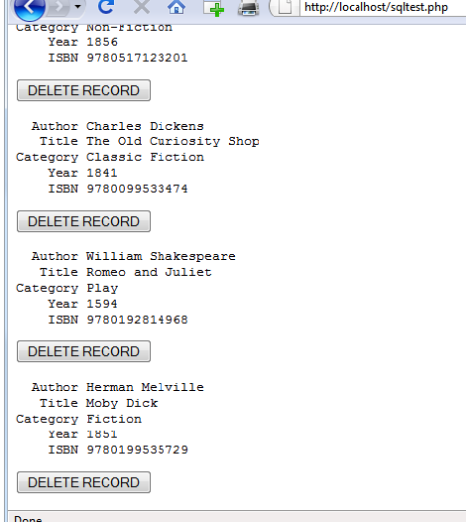

Slide 49
Running the Program
Now let’s look at how deleting a record works by creating a dummy record.
So try entering just the number 1 in each of the five fields and click the ADD RECORD button.
If you now scroll down, you’ll see a new record consisting just of 1s.
Obviously, this record isn’t useful in this table, so now click the DELETE RECORD button and scroll down again to confirm that the record has been deleted.

Slide 50
Running the Program
Assuming that everything worked, you are now able to add and delete records at will.
Try doing this a few times, but leave the main records in place (including the new one for Moby Dick), as we’ll be using them later.
You could also try adding the record with all 1s again a couple of times and note the error message that you receive the second time, indicating that there is already an ISBN with the number 1.

Slide 51
Practical MySQL
You are now ready to look at some practical techniques that you can use in PHP to access the MySQL database, including tasks such as:
creating and dropping tables;
inserting, updating, and deleting data;
protecting your database and website from malicious users

Slide 52
Creating a Table
Let’s assume that you are working for a wildlife park and need to create a database to hold details about all the types of cats it houses.
You are told that there are nine families of cats—Lion, Tiger, Jaguar, Leopard, Cougar, Cheetah, Lynx, Caracal, and Domestic—so you’ll need a column for that.
Then each cat has been given a name, so that’s another column, and you also want to keep track of their ages, which is another.
Of course, you will probably need more columns later, perhaps to hold dietary requirements, inoculations, and other details, but for now that’s enough to get going.
A unique identifier is also needed for each animal, so you also decide to create a column for that called id.

Slide 53
<?php
require_once 'login.php’;
$conn = new mysqli($hn, $un, $pw, $db);
if ($conn->connect_error) die($conn->connect_error);
$query = "CREATE TABLE cats (
id SMALLINT NOT NULL AUTO_INCREMENT,
family VARCHAR(32) NOT NULL,
name VARCHAR(32) NOT NULL,
age TINYINT NOT NULL,
PRIMARY KEY (id)
)";
$result = $conn->query($query);
if (!$result) die ("Database access failed: " . $conn->error);
?>
As you can see, the MySQL query looks pretty similar to how you would type it directly in the command line, except that there is no trailing semicolon, as none is needed when you are accessing MySQL from PHP.

Slide 54
Describing a Table
When you aren’t logged into the MySQL command line, here’s a handy piece of code that you can use to verify that a table has been correctly created from inside a browser.
It simply issues the query DESCRIBE cats and then outputs an HTML table with four headings—Column, Type, Null, and Key—underneath which all columns within the table are shown.

Slide 55
<?php
require_once 'login.php’;
$conn = new mysqli($hn, $un, $pw, $db);
if ($conn->connect_error) die($conn->connect_error);
$query = "DESCRIBE cats";
$result = $conn->query($query);
if (!$result) die ("Database access failed: " . $conn->error);
$rows = $result->num_rows;
...

Slide 56
…
echo "<table><tr><th>Column</th><th>Type</th><th>Null</th><th>Key</th></tr>";
for ($j = 0 ; $j < $rows ; ++$j)
{
$result->data_seek($j);
$row = $result->fetch_array(MYSQLI_NUM);
echo "<tr>";
for ($k = 0 ; $k < 4 ; ++$k) echo "<td>$row[$k]</td>";
echo "</tr>";
}
echo "</table>";
?>

Slide 57
The output from the program should look like this:
Column Type Null Key
id smallint(6) NO PRI
family varchar(32) NO
name varchar(32) NO
age tinyint(4) NO

